Slide 1
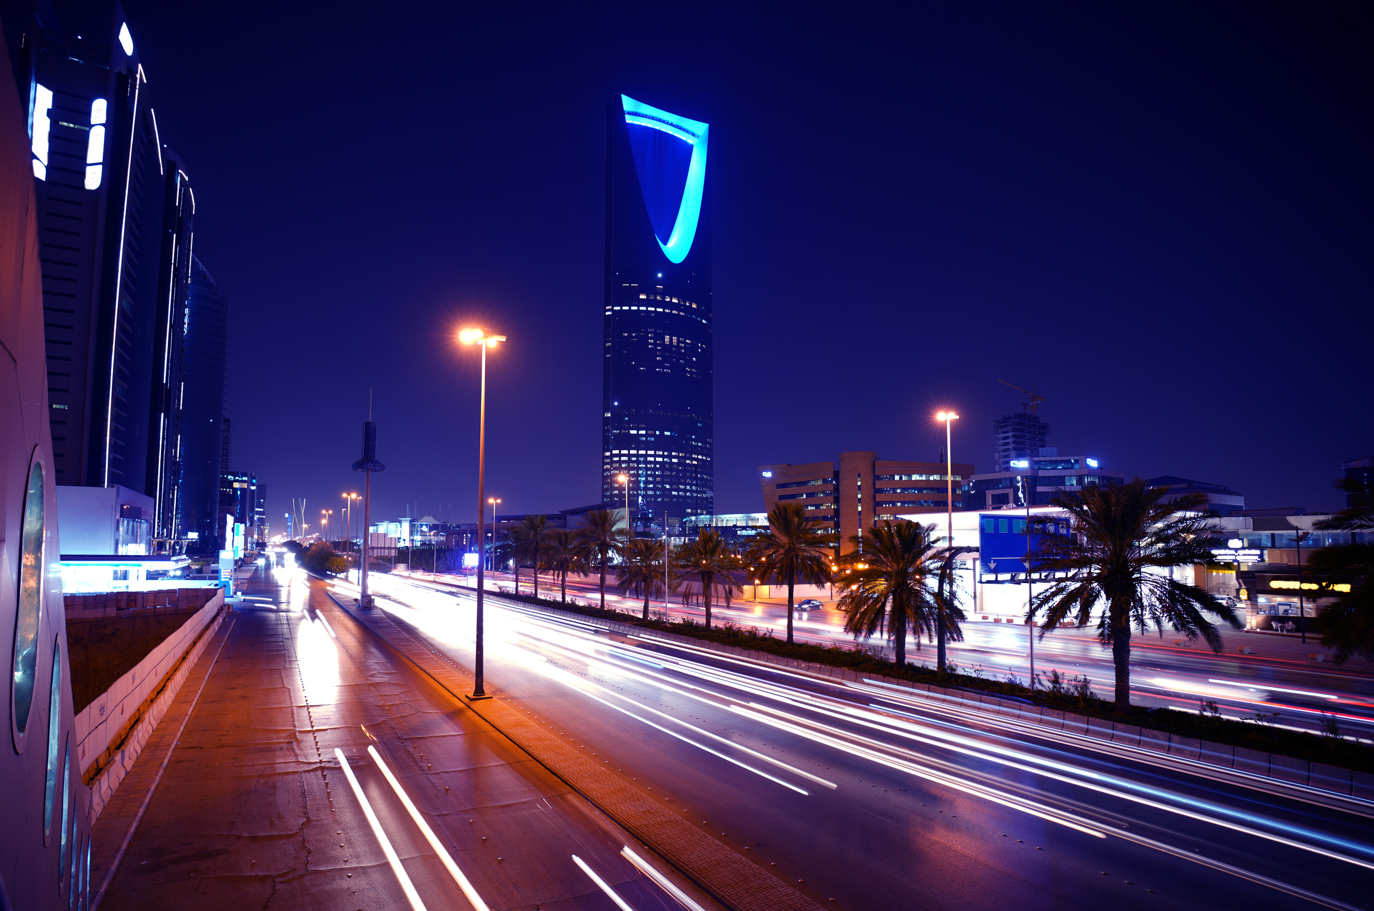

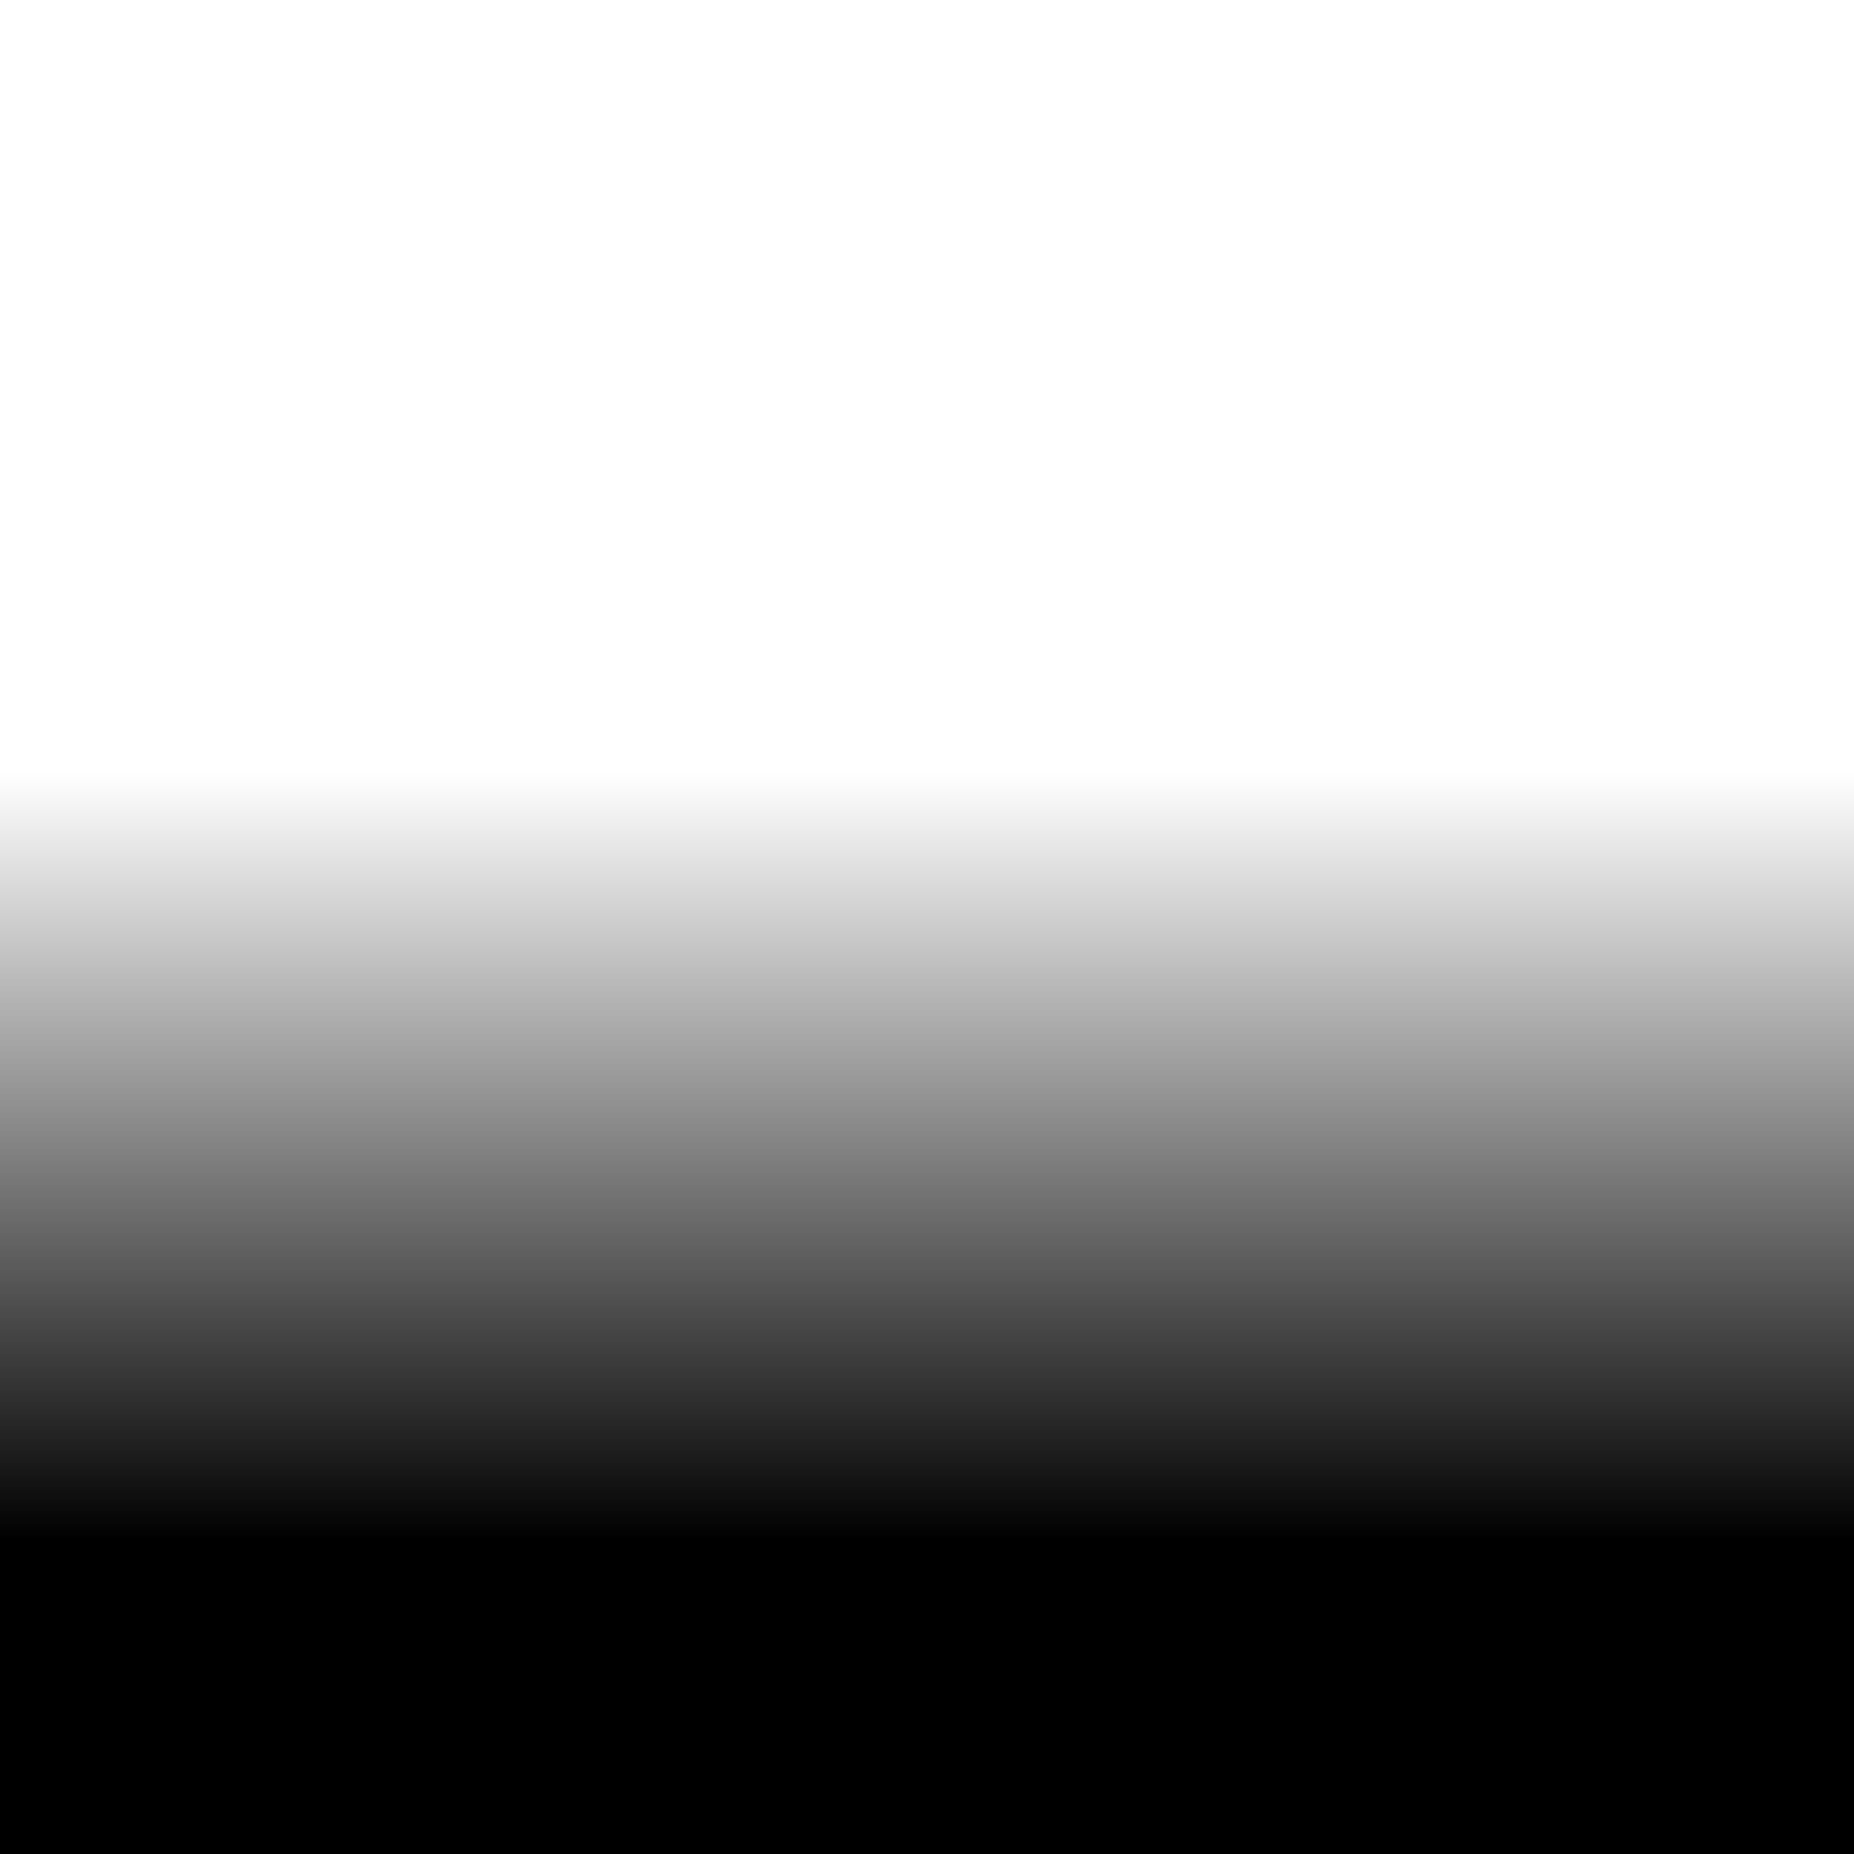
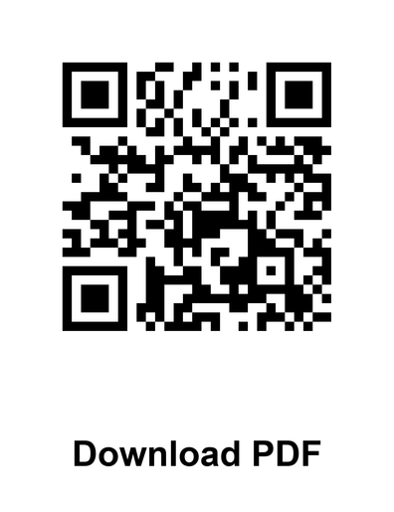

COMPANY
PROFILE
Shaping tomorrow through exceptional construction and infrastructure development aligned with Vision 2030.

Slide 2
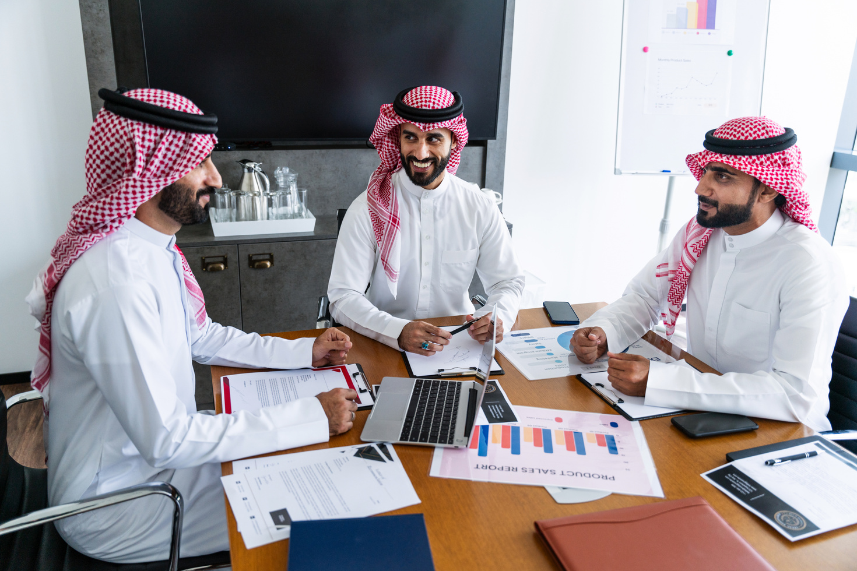

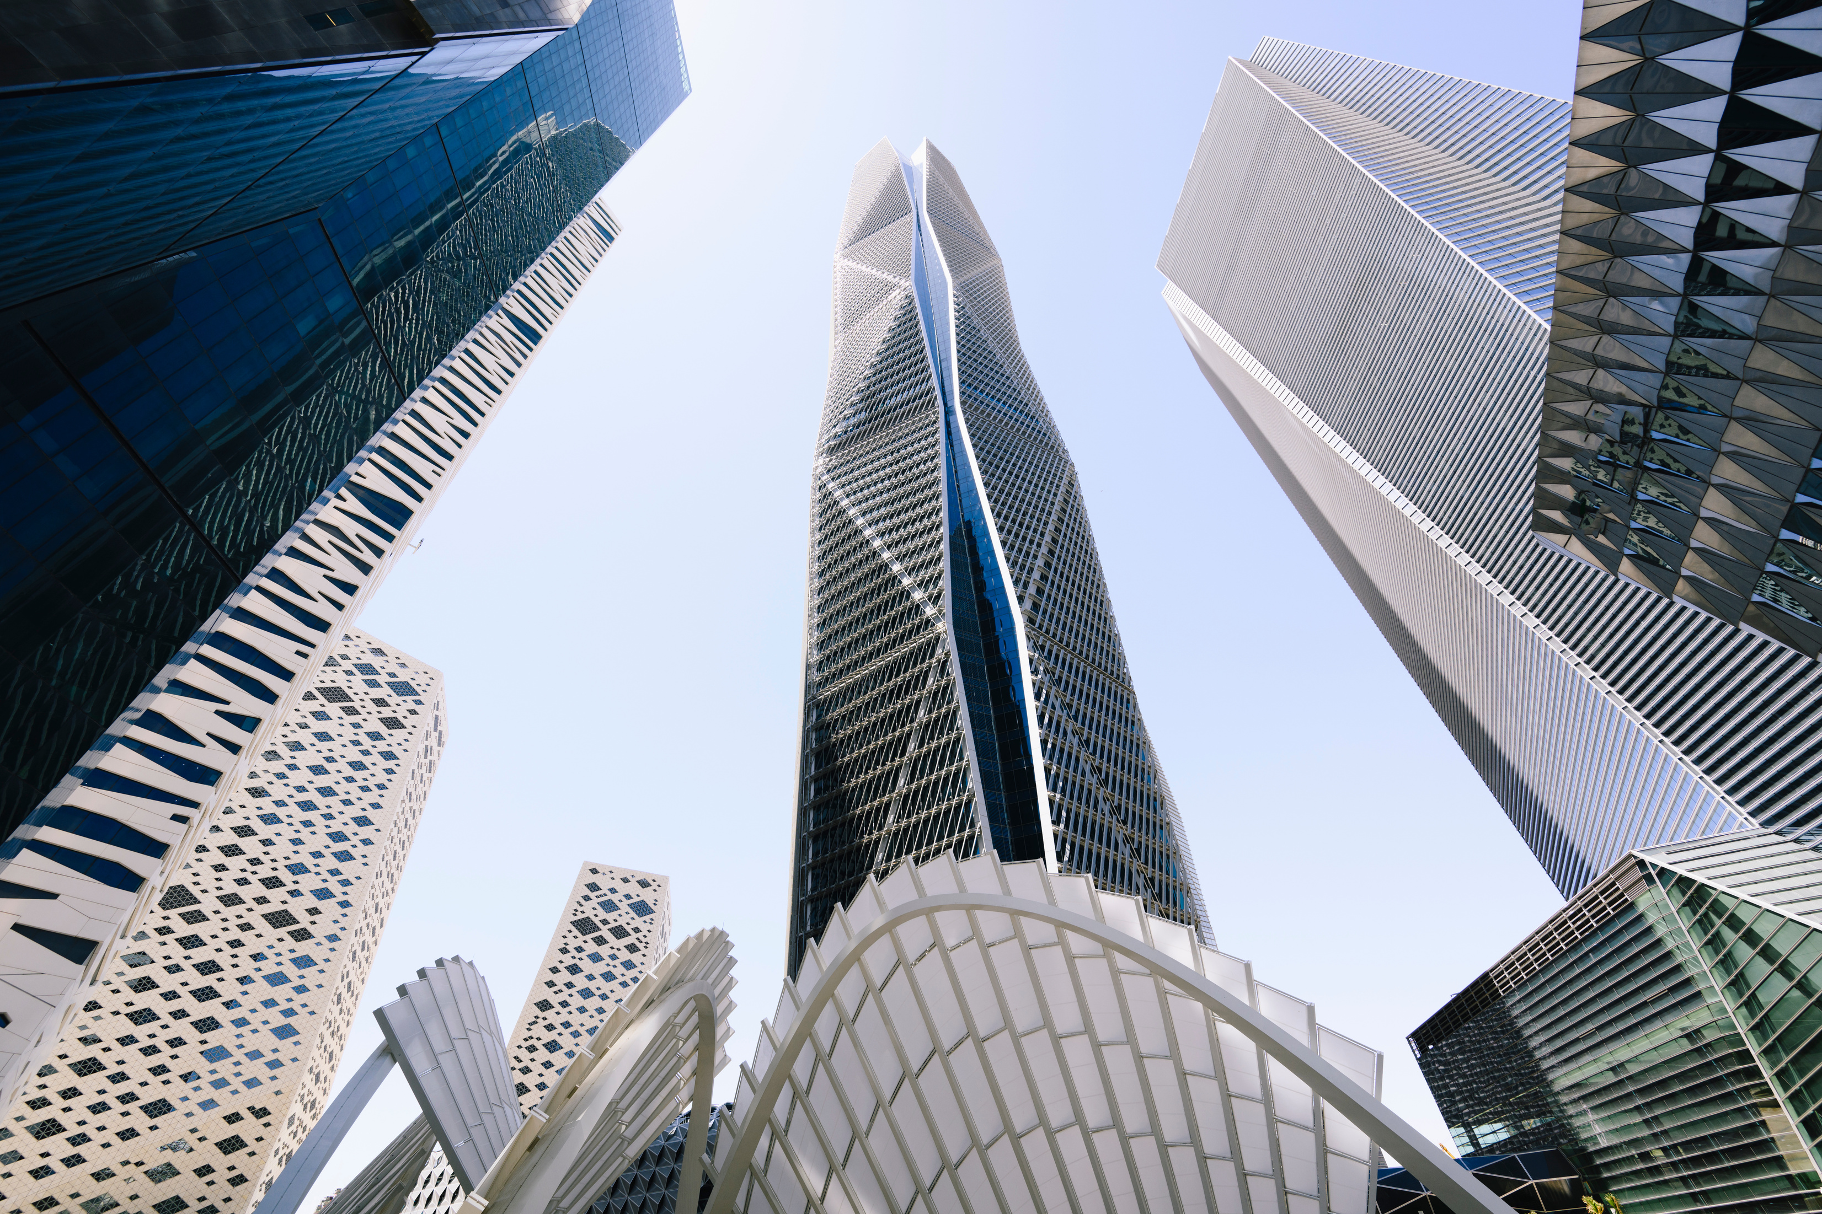
COMPANY PROFILE
A Brief Story About The Company
ABOUT US
Founded in 2000, StrivePoint Company has grown into one of Saudi Arabia’s leading construction, trading, and investment companies. With over two decades of proven experience, we have built a strong reputation for credibility, reliability, and excellence in the market.
Supported by highly qualified technical, administrative, and financial resources, StrivePoint delivers integrated solutions across a wide range of government and private sector projects. We remain committed to contributing to the Kingdom’s ambitious development plans by executing high-quality projects efficiently and within required timelines.
Strictly Confidential, For Recipient Only
001

Slide 3
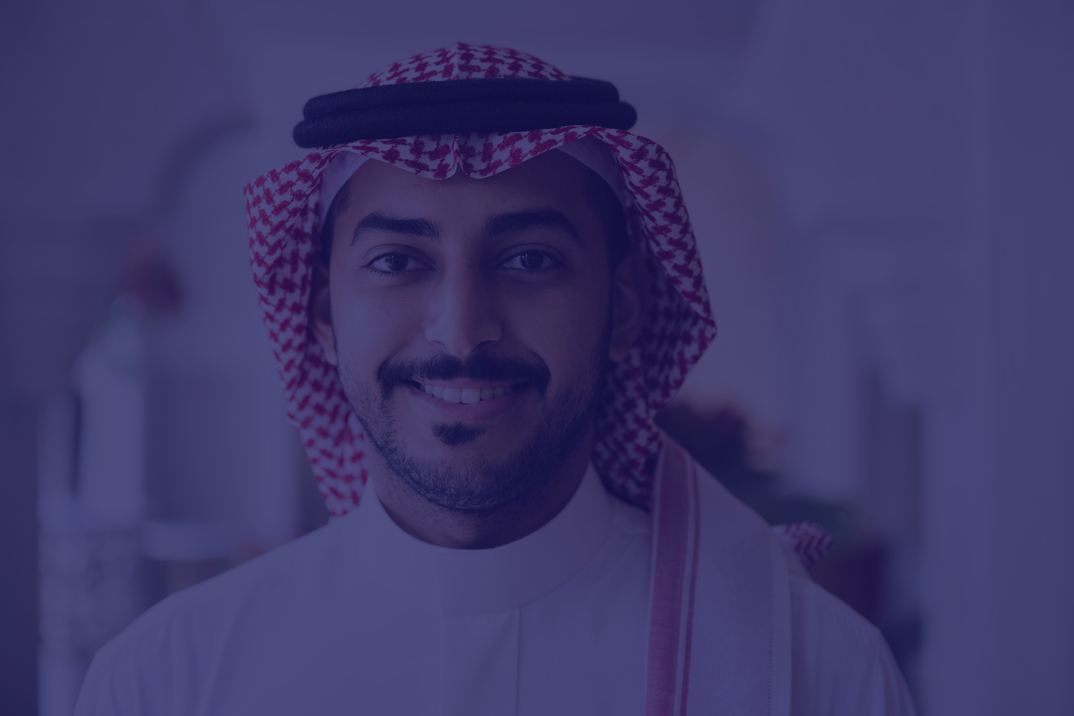
BUSINESS
APPROACH
002

Slide 4

COMPANY PROFILE
OUR STRATEGY
Our future strategy is focused on consolidating the company’s leadership position in the contracting sector while capitalizing on the significant economic growth opportunities within the Kingdom of Saudi Arabia and across the GCC region.
01
02
03
Market Leadership
Regional Expansion
Competitive Readiness
Reinforce our position as a trusted leader in the contracting industry through consistent performance and strong client relationships.
Leverage economic growth across Saudi Arabia and the Gulf states to expand our footprint and diversify our project portfolio.
Prepare for increasing competition by enhancing efficiency, adopting advanced technologies, and developing strategic partnerships.
04
05
06
Quality & Timely Delivery
Operational Excellence
Innovation & Sustainability
Ensure the highest standards of quality while delivering projects within agreed timelines and budgets.
Enhance systems, processes, and workforce performance for sustainable growth.
Adopt innovative and sustainable practices to deliver long-term value.
Strictly Confidential, For Recipient Only
003

Slide 5

OUR
FUTURE
004

Slide 6
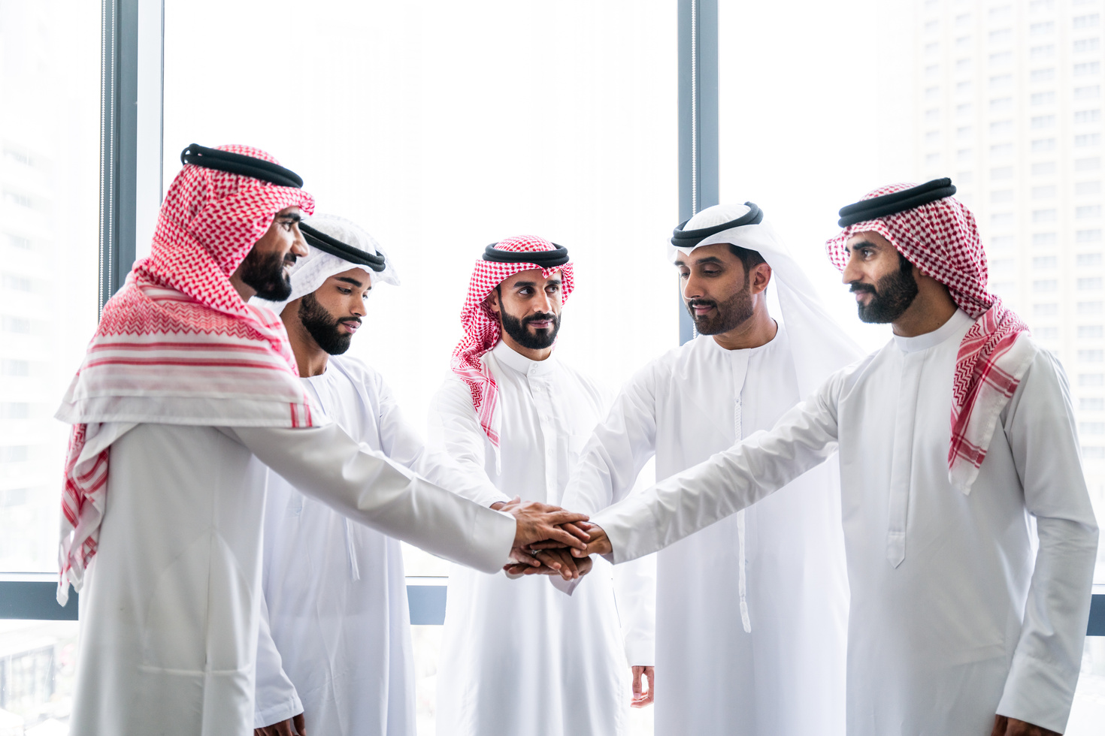

COMPANY PROFILE
VISION & OBJECTIVES
StrivePoint Company aims to be a pioneer in development and investment by delivering the highest standards of service, performance, and project excellence. We are committed to building a strong reputation where the StrivePoint name is synonymous with quality, reliability, and service excellence.
MISSION
01
Deliver Excellence
02
Ensure Client Satisfaction
Provide high-quality services and strong project performance, ensuring precision, reliability, and professional standards in every assignment.
Build lasting partnerships through transparency, understanding client needs, and delivering projects on time and within budget.
03
Develop Our People
04
Act with Responsibility
Support continuous training and professional growth to strengthen expertise, innovation, and leadership.
Operate with integrity and accountability while contributing to sustainable growth and positive community impact.
Strictly Confidential, For Recipient Only
005

Slide 7
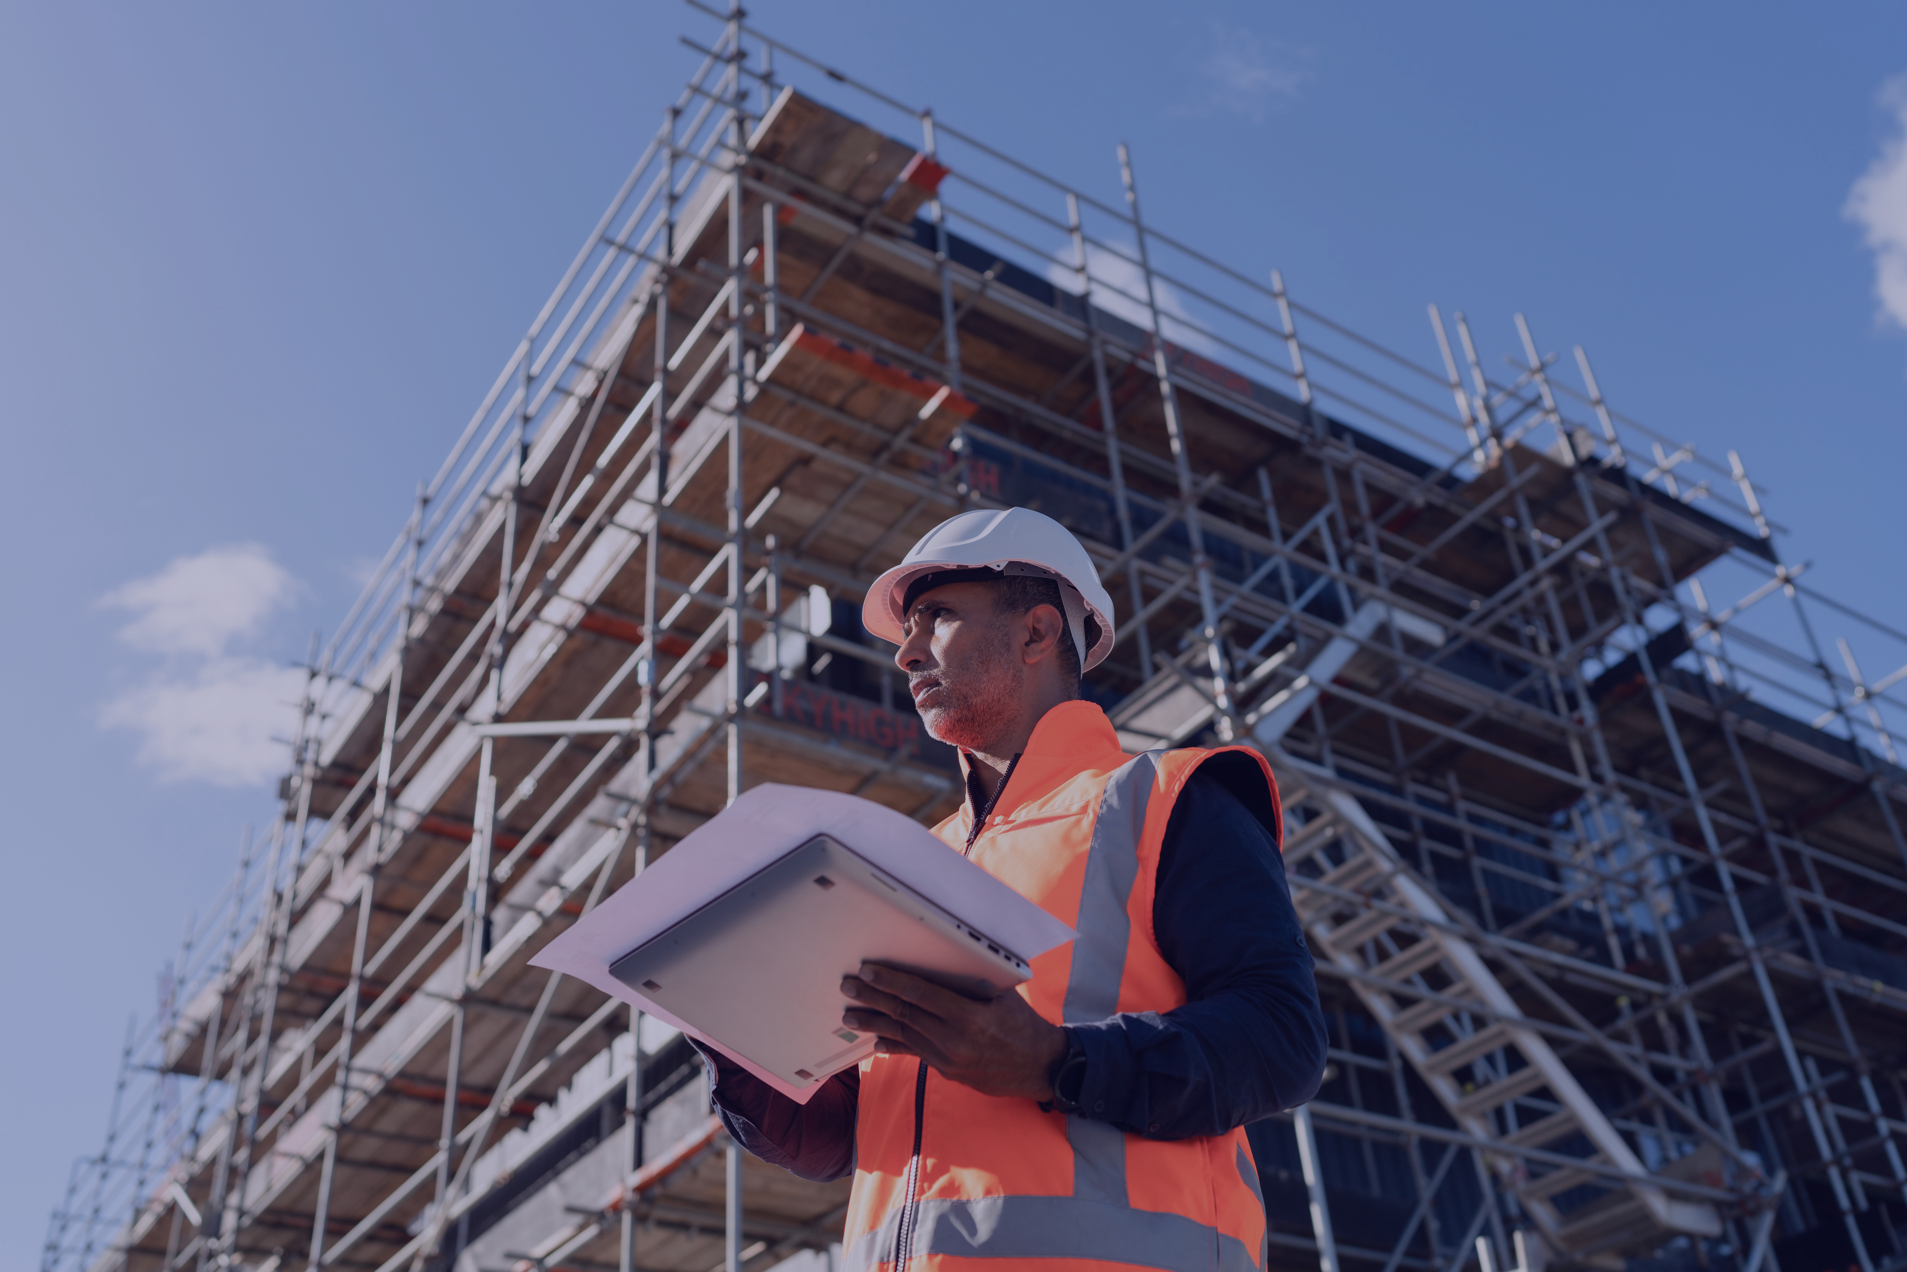
CIVIL CONSTRUCTION
006

Slide 8




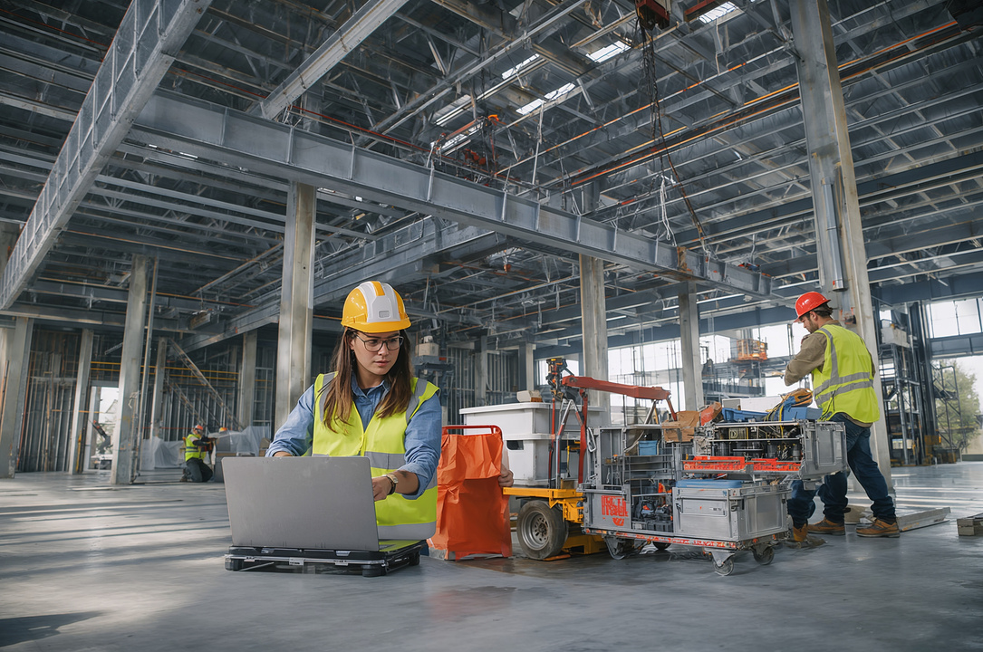
COMPANY PROFILE
CIVIL CONSTRUCTION
PORTFOLIO
Our Construction Expertise
Our civil construction portfolio reflects our commitment to delivering high-quality, precise, and reliable construction solutions across diverse infrastructure and building projects.
Strictly Confidential, For Recipient Only
007

Slide 9
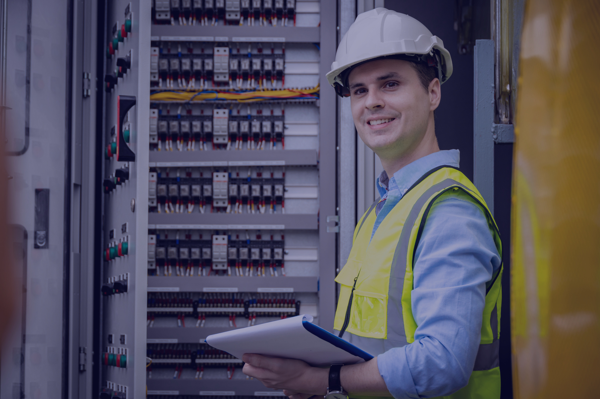
ELECTRICAL ENGINEERING
008

Slide 10
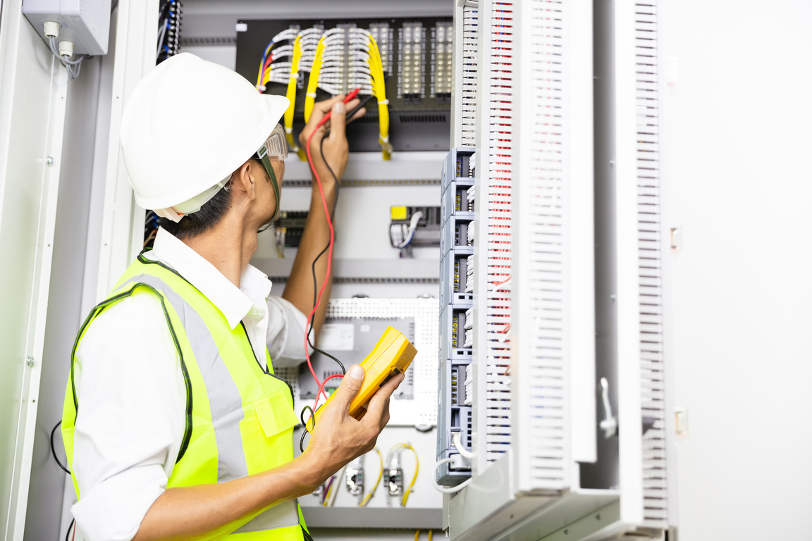
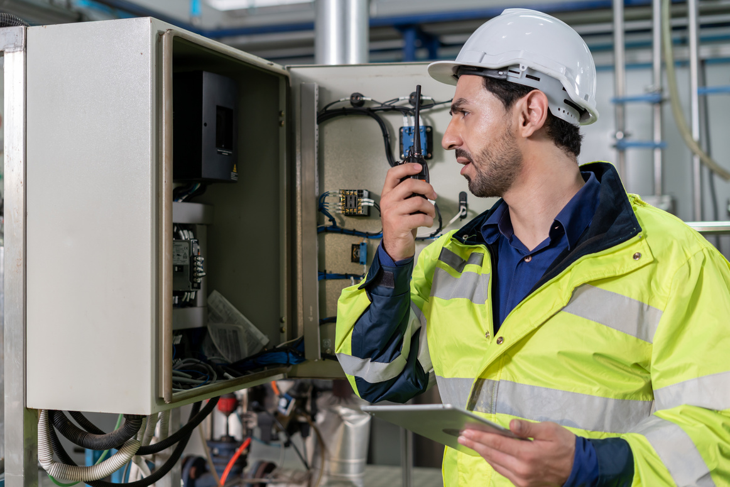
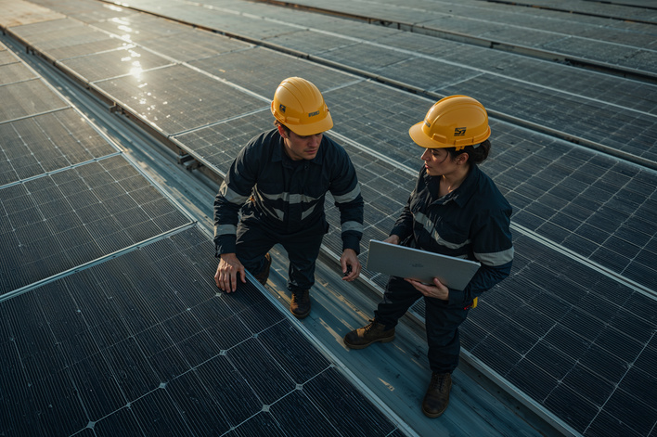
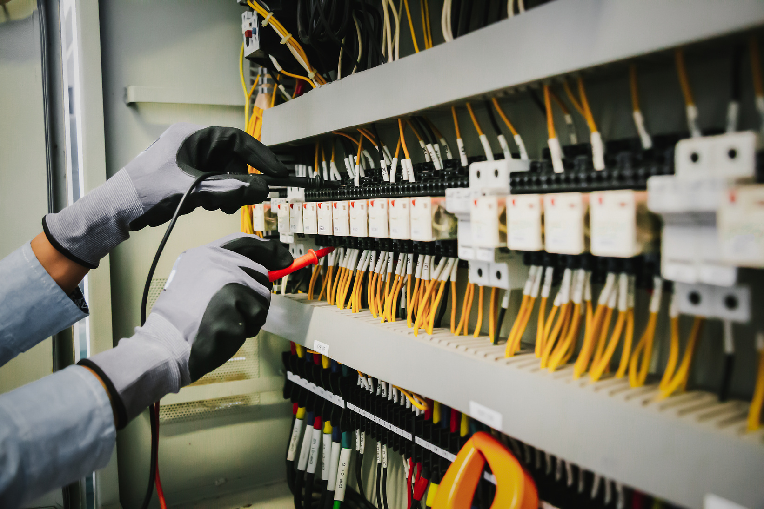
COMPANY PROFILE
ELECTRICAL ENGINEERING
PORTFOLIO
Our Electrical Expertise
We deliver reliable, high-quality electrical engineering solutions with a focus on innovation, safety, and performance across various projects.
Strictly Confidential, For Recipient Only
009

Slide 11
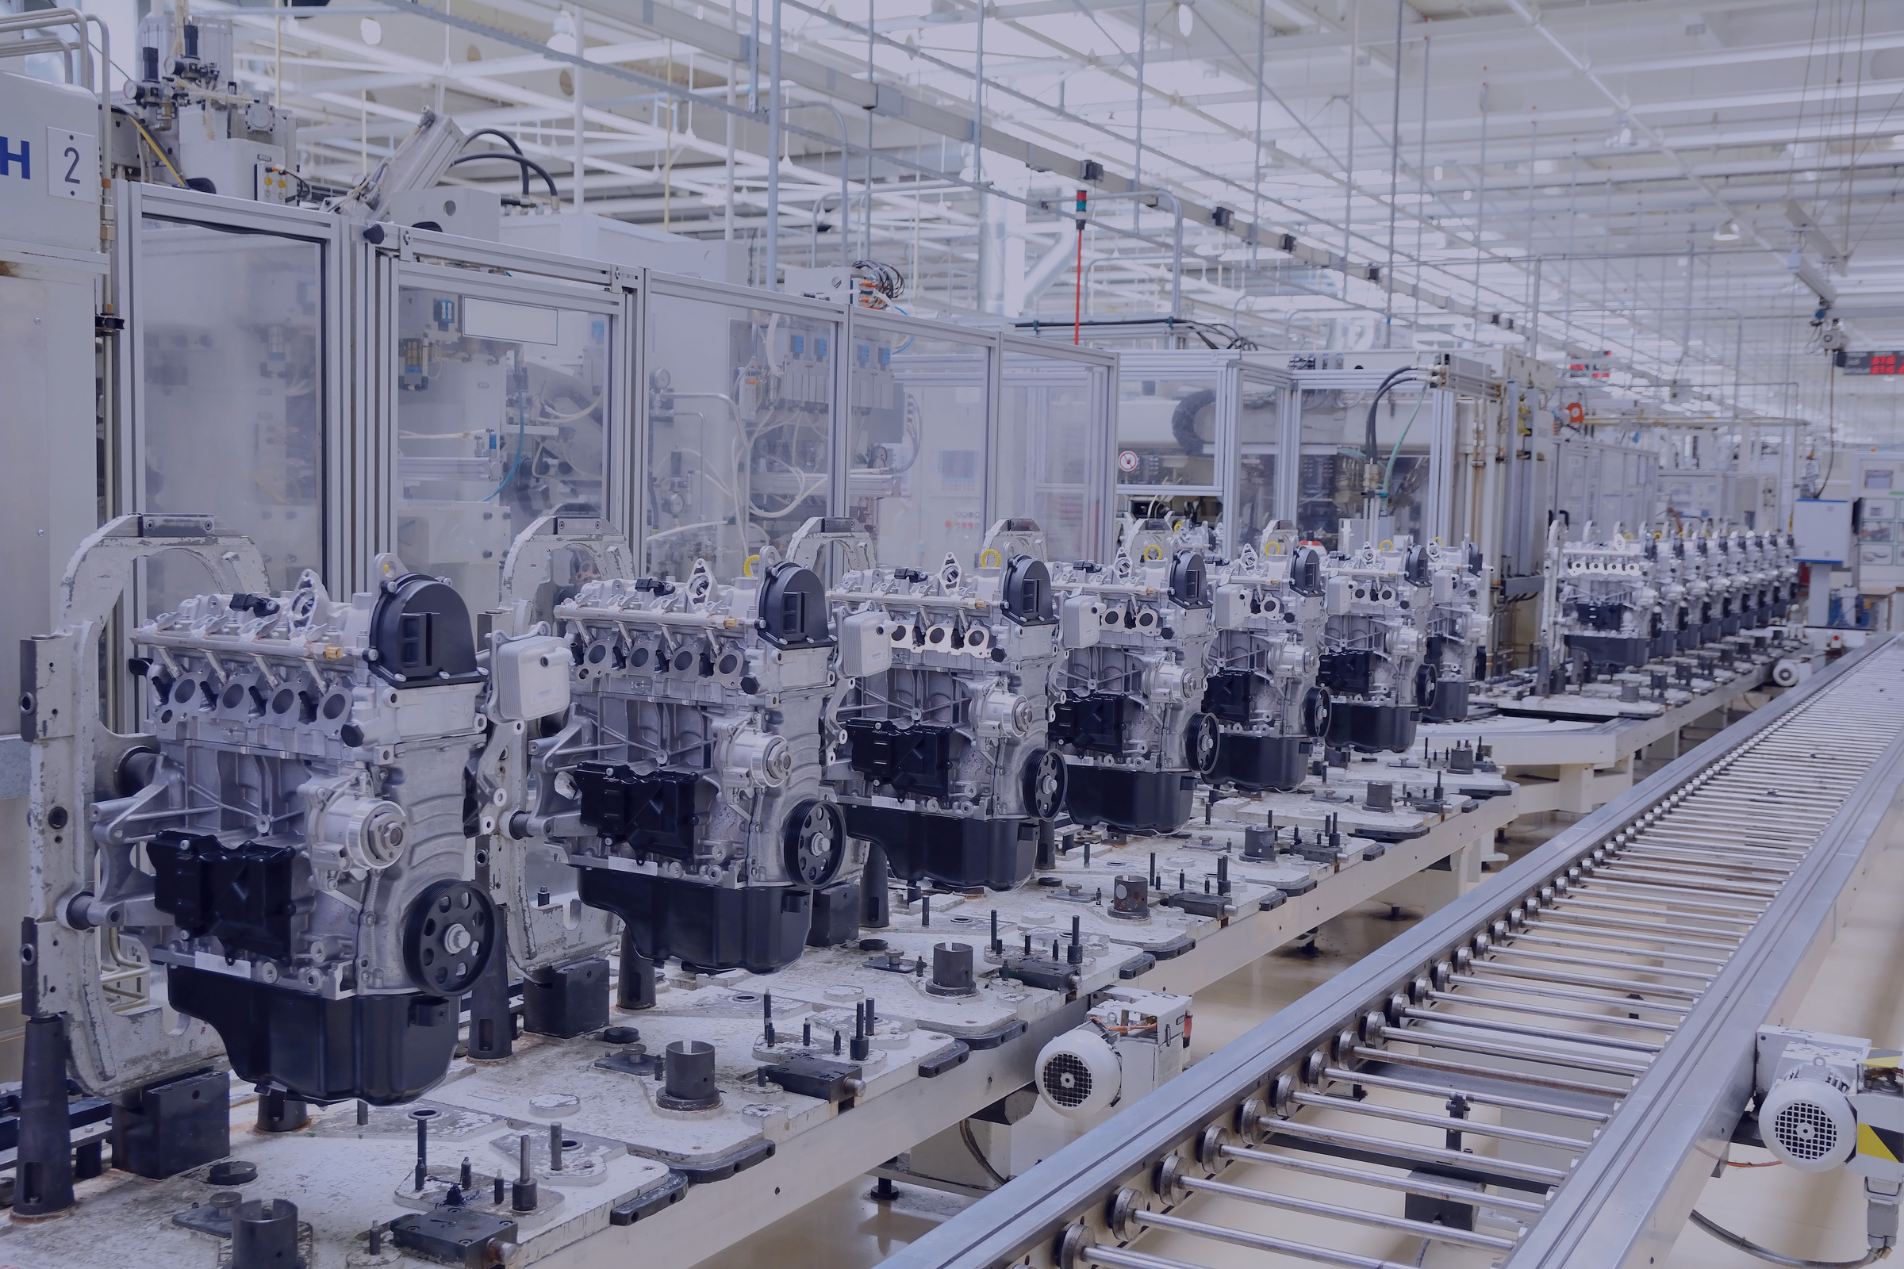
MECHANICAL ENGINEERING
010

Slide 12


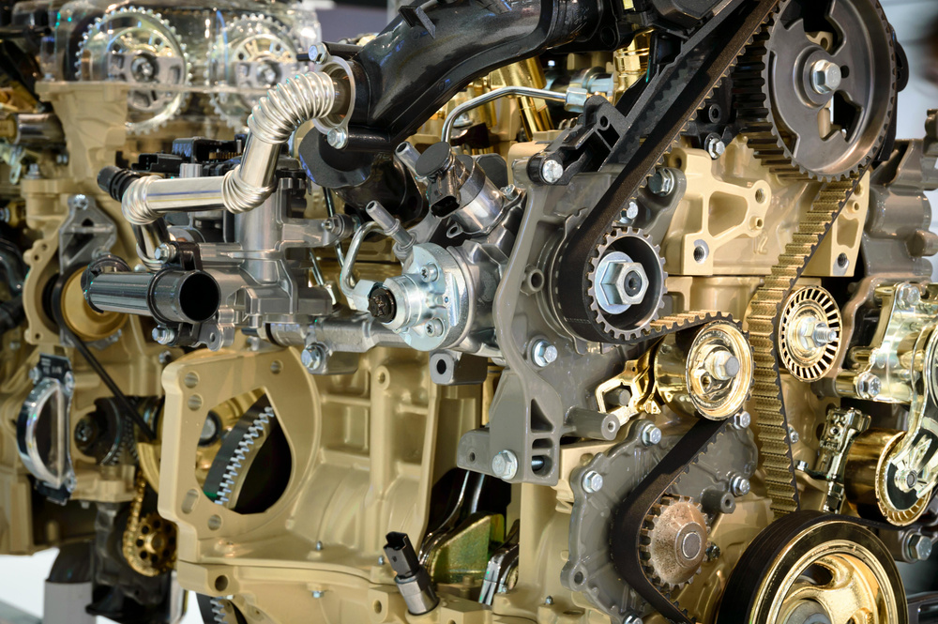
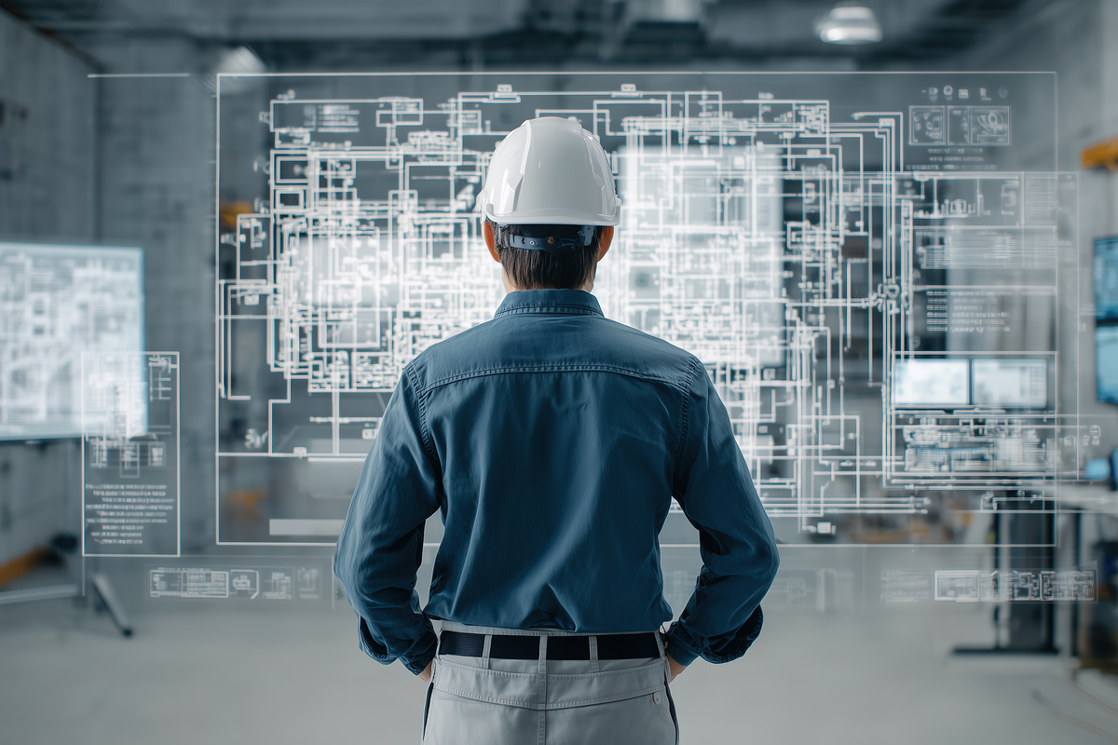
COMPANY PROFILE
MECHANICAL ENGINEERING
PORTFOLIO
Our Mechanical Expertise
We provide reliable and high-quality mechanical engineering solutions, focusing on precision, innovation, and efficient system performance across diverse projects.
Strictly Confidential, For Recipient Only
011

Slide 13

SOLAR SYSTEM
012

Slide 14

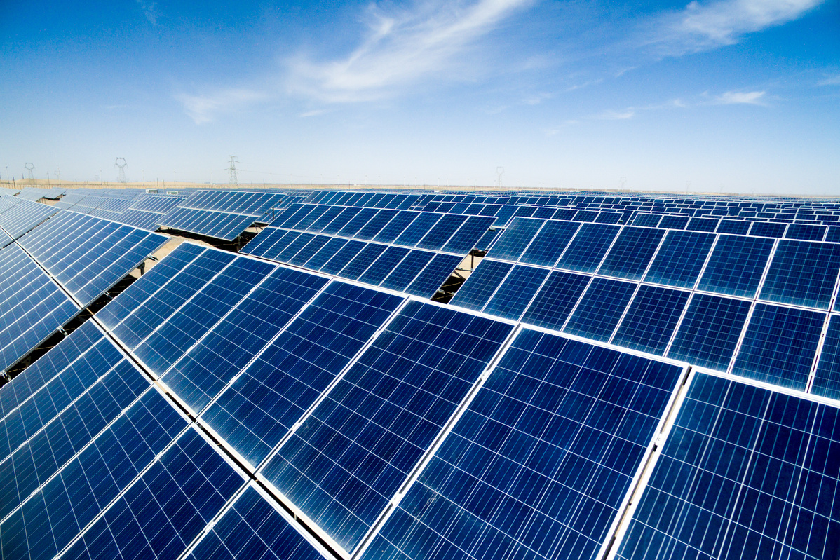


COMPANY PROFILE
SOLAR SYSTEM
PORTFOLIO
Our Solar System Expertise
We deliver efficient and sustainable solar energy solutions, focusing on innovation, reliability, and long-term performance for modern energy needs.
Strictly Confidential, For Recipient Only
013

Slide 15












OUR CLIENTS
014

Slide 16










OUR CLIENTS
014

Slide 17

DOCUMENTATION
015

Slide 18
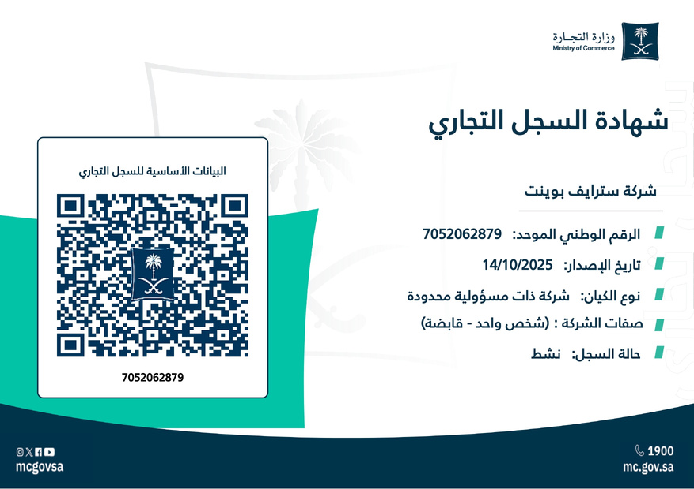
COMPANY PROFILE
OUR
DOCUMENTATION
Corporate Records & Documentation
A collection of essential company documents, technical records, and professional resources supporting our operations, standards, and project execution.
Strictly Confidential, For Recipient Only
016

Slide 19




THANK YOU
Washam Street, District Al Murabah, P.O.BOX 12631 Riyadh Saudi Arabia
+966 1 12355513
info@strivepoint-sa.com
017

